Slide 1
15 Puzzle
Jeji Vedullapalli
Venkatesh Javvaji

Slide 2
Contents
Introduction
Demo
Sample Code

Slide 3
Introduction
15 Puzzle is a Sliding puzzle with square blocks to move.
Boxes move block by block
Fun game to solve

Slide 4
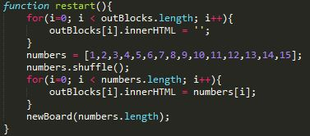
Sample Code

Slide 5
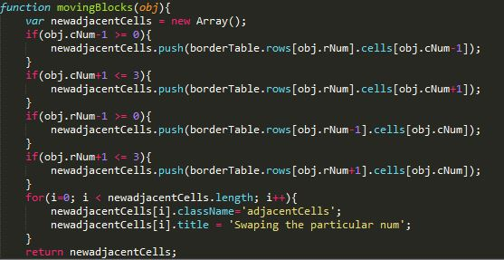
Sample Code

Slide 6

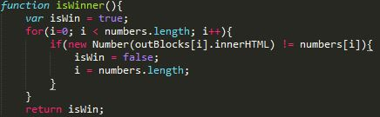
Sample Code

Slide 7
Demo

Slide 8
Thank you !!

